Slide 1


Integration Quarto Markdown with Python for Inline Code Dynamic Reporting
Date: 24 - 26 September 2024

Slide 2



Teaching Teams
Victor
Irfan
Rany
Instructor
Teaching Assistant
Teaching Assistant

Slide 3

Have You Ever Heard About
Inline Code & Dynamic Reporting?

Slide 4

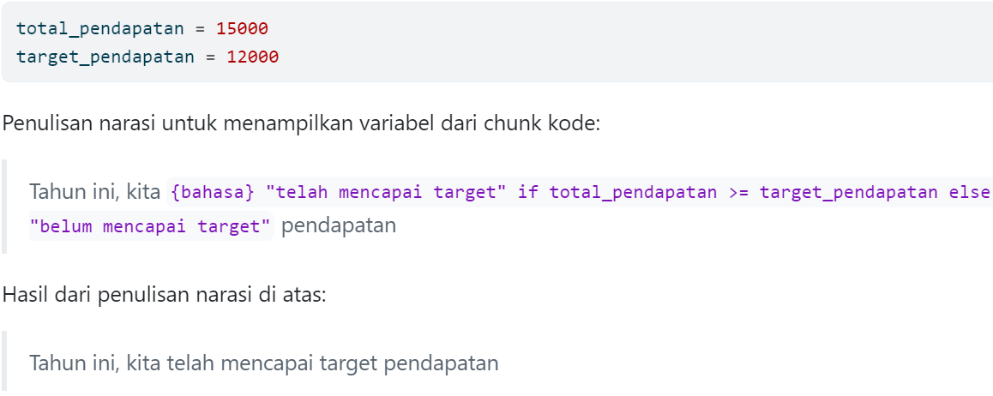
Definition Inline Code
Inline Code is the process when code of program is inserted into a text or narration

Slide 5

Implementation Inline Code
Dynamic Reporting
To present findings
Adaptively change based on input
Type of reporting that generates/updates reports based on changes to the data sources

Slide 6

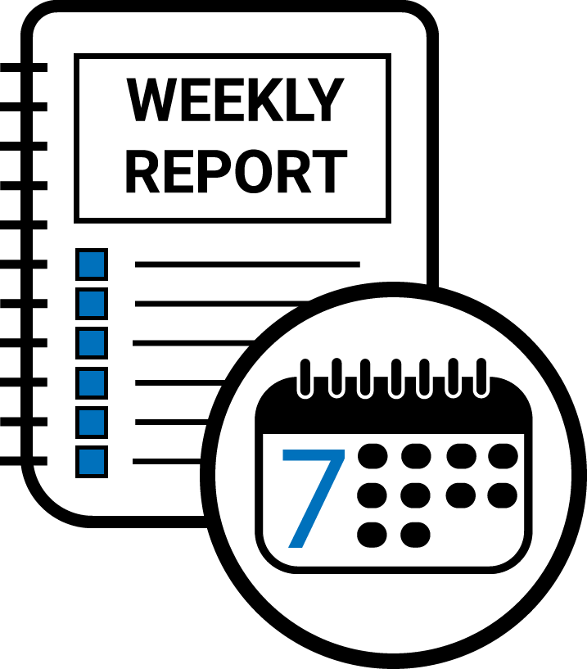

Why Inline Code Powerfull for Reporting?
Weekly
Reduce Workload
Scheduled Timeline
Monthly
Yearly
Narrative
Reproducible Code
Normally Same Content
Data

Slide 7
Tools to Implement
Inline Code for Dynamic Reporting

Slide 8





Tools
Myth
The coding language
&
Fact
“At the end of the day, we want to get the work done - not worry about tools.”

Slide 9


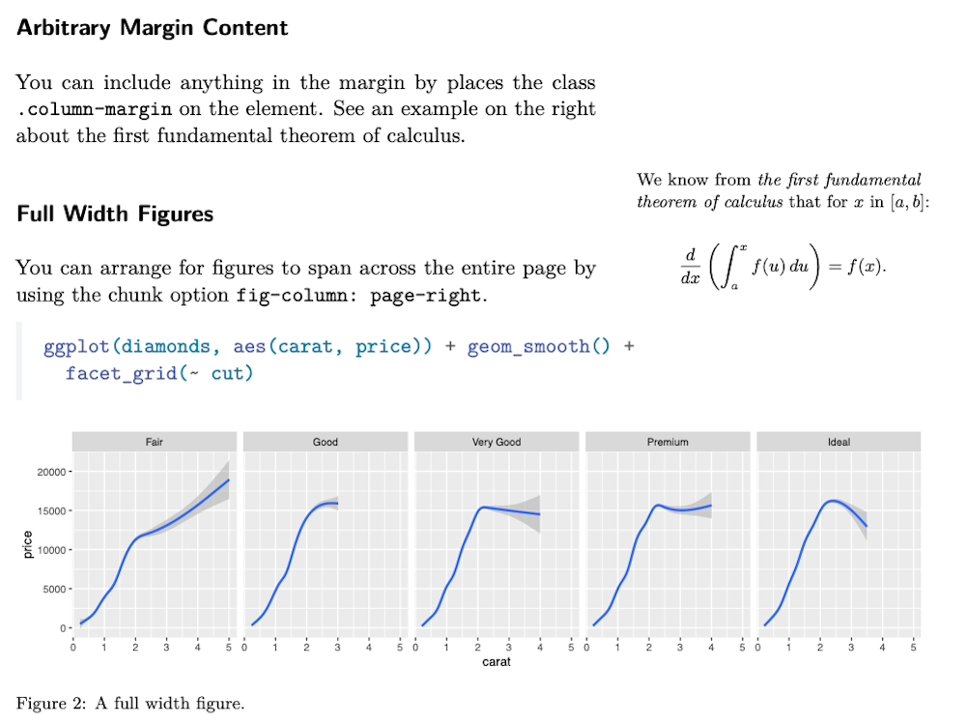

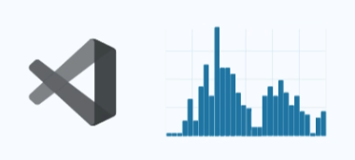
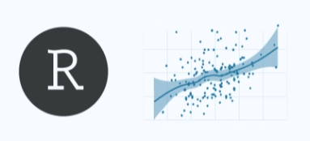
Quarto Markdown
Jupyter Backend Engine
Wide Variety Output Format
Suitable for Various IDE

Slide 10
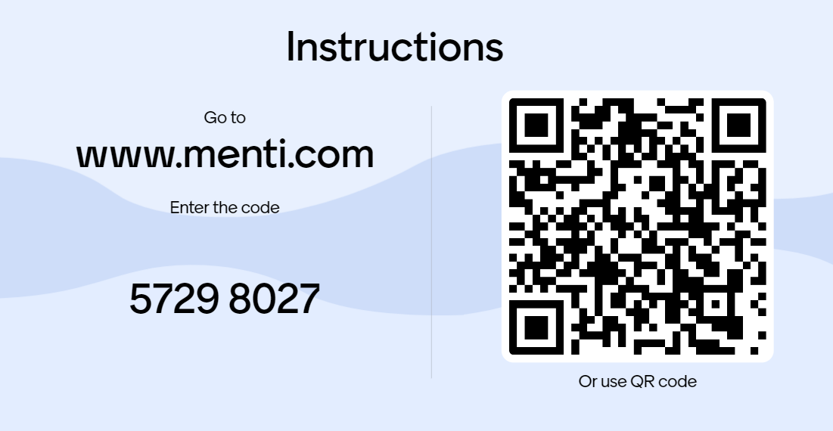
Background Check

Slide 11
Our
Road Map

Slide 12
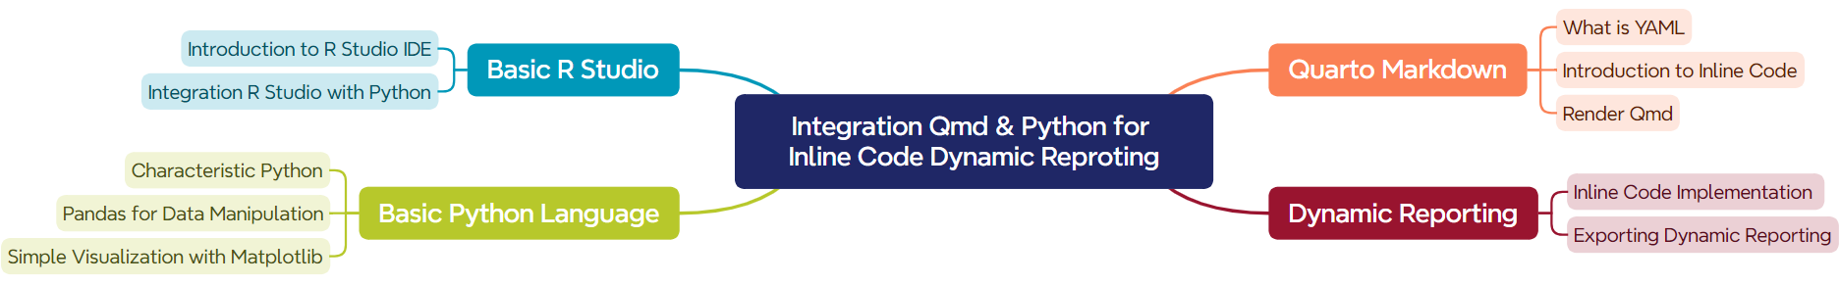
Mind Map

Slide 13
LET’S GO TO IN CLASS Qmd

Slide 14

Thank You

